Slide 1
The Future of Teaching About the Past
Mills Kelly
George Mason University
@EdwiredMills
Notes:
The Future of Teaching About the Past
Mills Kelly
George Mason University
I want to begin my lecture today with several thank yous.
First I want to thank the Gutenberg Teaching College for selecting me as the 2019 recipient of the Gutenberg Teaching Award. Receiving this award has truly been the highlight of my career.
Second, I want to thank Dr. Andreas Frings and Professor Dr. Meike Hensel-Grobe first for nominating me for this prestigious award and then for organizing my visit to Mainz.
I should also thank the creators of the Moderna vaccine, who helped make my trip possible as well.
Like all of us, I am sorry that Covid-19 has made our lives so complicated. I would much rather be in a room with you than speaking to you via Teams and live stream.
But these are the times we live in and as historians we know these times will change.
The topic of my lecture this evening is the future of teaching about the past.
This topic makes me just a bit nervous because historians are famously bad at predicting the future because we have a hard enough time predicting the past!
Therefore, I hope none of you will re-watch the recording of this lecture ten years from now – unless I am right about most of what I propose, in which case I hope you will all watch the recording again!

Slide 2
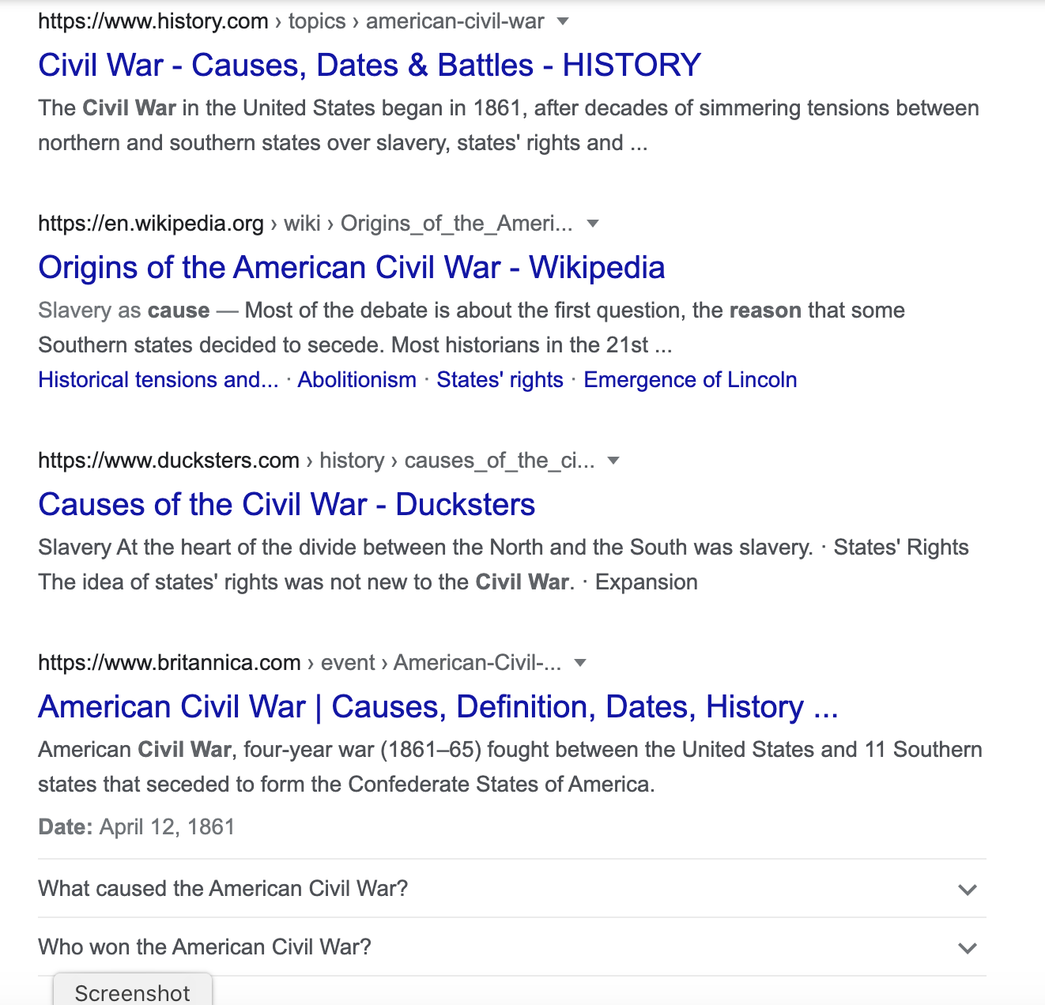
From Scarcity to Abundance
Greenandturquoise.com
Notes:
The story I want to tell today is deeply rooted in the traditions of how we teach about the past, traditions heavily shared by German and American history educators.
The teaching and learning of history, of course, has a very long history all its own.
In the Euro-American tradition we can look back as far as Ancient Greece and Rome for models of how philosophers believed their students ought to learn about the past.
Their concerns were centered on events and ideas and understanding how those great events—the Persian Wars, the invasions of Rome by tribes from the East, the rise of new religious beliefs—changed the ways that humans understood their place in the world and in the grand stream of time.
That classical vision of the role of history in the education of young men—and eventually young women—held sway for at least 2,000 years.
And then in the 19th century, historians like von Ranke and educational philosophers like John Dewey changed the way we teach, requiring their students to focus on the close reading of texts and to engage in archival research of their own devising in order to make sense of the past by focusing on increasingly narrow and specialized topics.
Large lectures continued to be an important foundation of history teaching, but small research seminars also found their way into the curriculum, making the study of history much more personal.
Those 19th century innovations in history teaching meant that students were expected to do what historians do – research, analyze, and write.
As transformative as this new to teaching about the past was, it was always predicated on scarcity.

Slide 3
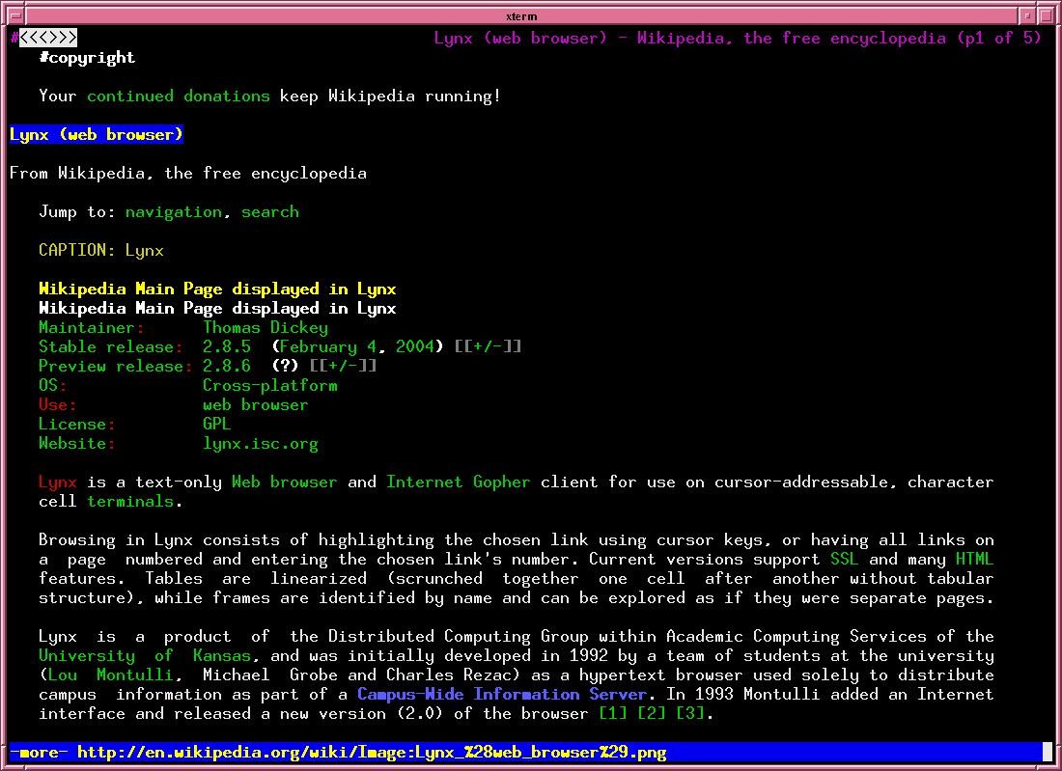
Wikipedia
Notes:
Students could really only research topics that drew on archival sources and published scholarship from local libraries and archives.
As educators, we made a tacit bargain with our students. We did not ask them to research topics that would require them to travel great distances and they (mostly) agreed to avoid such topics. Doing anything otherwise, except in the case of PhD students – who were often expected to travel great distances to do their work – would have been entirely impractical.
This approach to teaching quickly found its way into secondary school curricula, albeit at an even more limited scale. Younger students were expected to do similar kinds of research, analysis, and writing, but generally only using materials published in a textbook or collection of published documents.
The limitations of teaching history in an environment of scarcity were obvious – students were limited to a relatively small number of topics and those topics were far too often limited further to the elites who left behind large (or at least reasonably large) archival records. Far too often those members of the elite were wealthy or powerful white men.
Other voices were hard for students to locate.
In the 1960s our willingness to remain in the elite white male bubble began to break down and much of this change was driven by our students, large numbers of whom wanted to know more about the histories of women, of peasants and artisans, of minority groups, in short, of those whose lives were not as easily researched.
And the more we and our students looked at these “other” histories, the more the easy consensus about the past began to dissolve.
In the United States, for instance, we saw the emergence of a radical critique of the American project, a critique driven by what historians and their students learned about Black history, women’s history, the history of American imperialism, and the history of the Native American genocide.
Several decades later, technological change began to transform how we research, analyze, think, and write about the past in ways that almost no one could have predicted. Suddenly (in historical terms) historians and our students had access to more sources, more archives, more historical data than any one human could ever process.
I still remember the first time I taught a course in which my students used the Internet for their research. It was in the spring semester of 1997 and we were still using the Lynx web browser – plain text on a black screen.

Slide 4
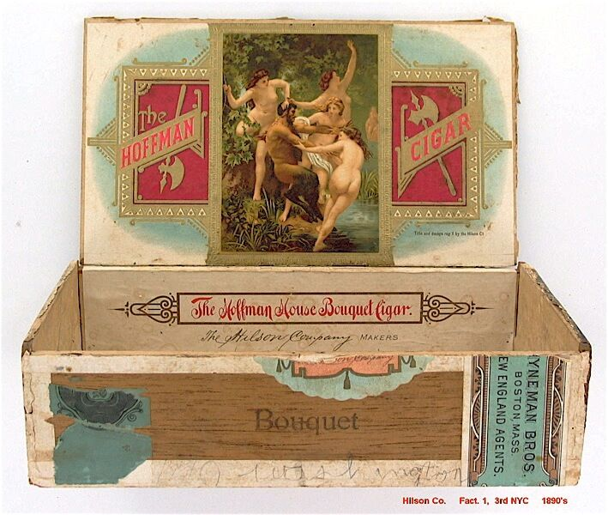
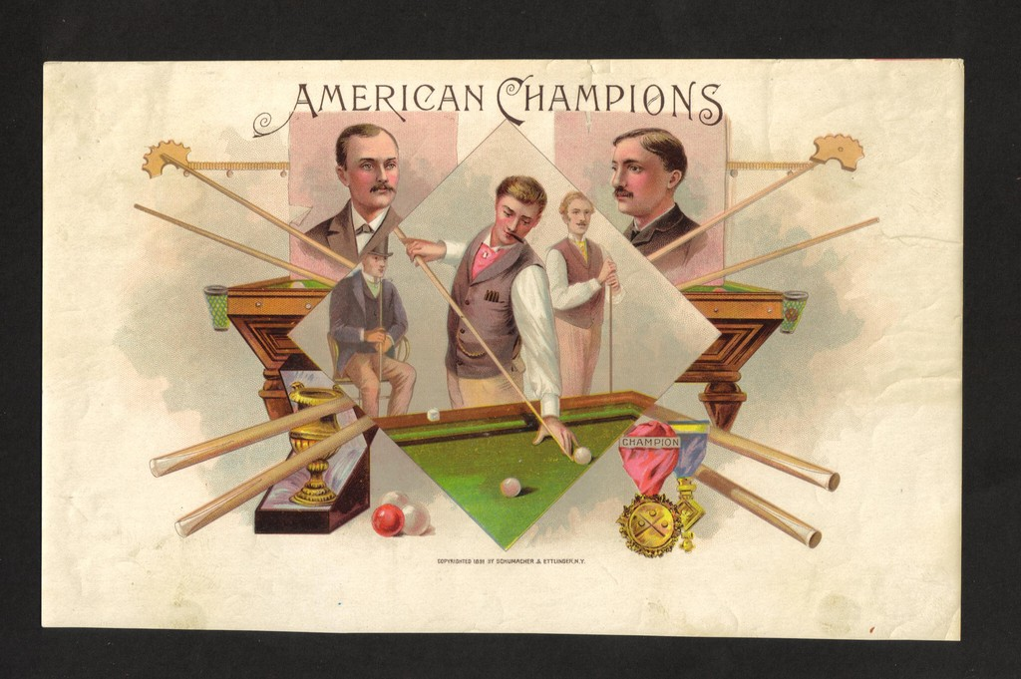
Prediction #1 – Student Creativity Will Flourish
meganchapman.wordpress.com
Hoffman House Cigar Box. 1873. National Cigar Museum.
Notes:
You could choose white, green, or brown for your text, but those were your only options. Netscape had been invented, but the university where I taught didn’t have sufficient computing power to let us engage in graphical web browsing.
There were quite literally thousands – thousands! – of historical sources available online in 1997. The scarcity that our teaching had been built on was melting away before our eyes.
Now it seems quaint to talk about thousands of sources being available online.
In 2018 I did a quick count of open source digital primary sources for history in the European languages and I came up with more than 75 million sources. That google search I showed on the earlier slide was for the “causes of the American Civil War.” Google says there are 131,000,000 hits.
So much for scarcity.
Coincidentally, it was around this same time that historians began to take seriously the idea that we could use our disciplinary methods to examine the ways that our students learn about the past.
A growing number of historians – I was one of the early adopters – began working in what we call the Scholarship of Teaching and Learning, a multi-disciplinary endeavor that tries to understand what works and what doesn’t in the teaching of any particular academic discipline.
My first project – very simple one
For the past 20 years, I have been trying to combine what I’ve learned as a practitioner of the Scholarship of Teaching and Learning with what I’ve learned as a digital historian to find new ways to teach and new ways to make history available to an ever-wider audience.
What I have distilled from that work are five predictions about the future of teaching about the past.
Prediction #1 – This is not a new one for me...I made this prediction way back in 2012, but I still stand behind it and have tried to live it.
Our students will increasingly use the creative possibilities posed by digital technology to make history in their own ways.
The more we can do to facilitate our students’ creative impulses, the more interesting history we will see them produce.

Slide 5
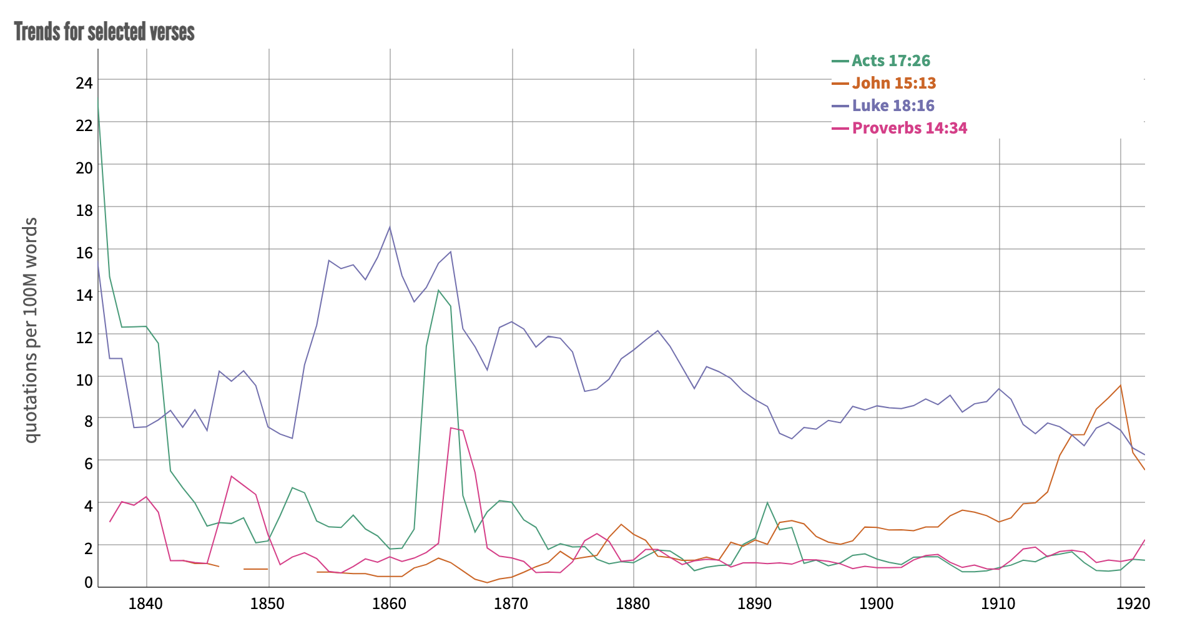
Prediction #2 – Increased Collaboration Across Disciplinary Boundaries
Notes:
As an example, I would offer the “Cigar Box Project”, originally developed by Canadian history teacher Neil Stephenson in 2009.
His students pick a topic in Canadian history, research it extensively, and over the course of the term devise a cigar box that depicts their interpretation of that topic. They then create a podcast episode in which they explain their cigar box, why they made the choices they made and then post images of their work online.
Similarly, yesterday I sat in on Meike’s didactics course where there were five groups of students planning lessons for secondary school students about the kindertransport of 1939 and they had four very different ideas about how to teach that lesson, all involving some sort of digital work.
Young people love the creative potential of the Internet. It’s up to us as historians to let them use that potential to create new forms of history—forms of history we might never think of.
Prediction #2 – In the coming decade we will find that we have more and more common ground with our colleagues in computer science, engineering, and geographic information systems.
It will be through collaborations with these colleagues that we will find new ways to do our own work and, just as importantly, to help our students do work that lives at the intersection of the sciences and the humanities.
At my own research center, I have colleagues doing just this, and we are now teaching history students computational methods, how to use network analysis to make sense of historical big data, and how to gain new insights about the past using the methods of geographers and digital archaeologists.
For example – Explain America’s Public Bible

Slide 6
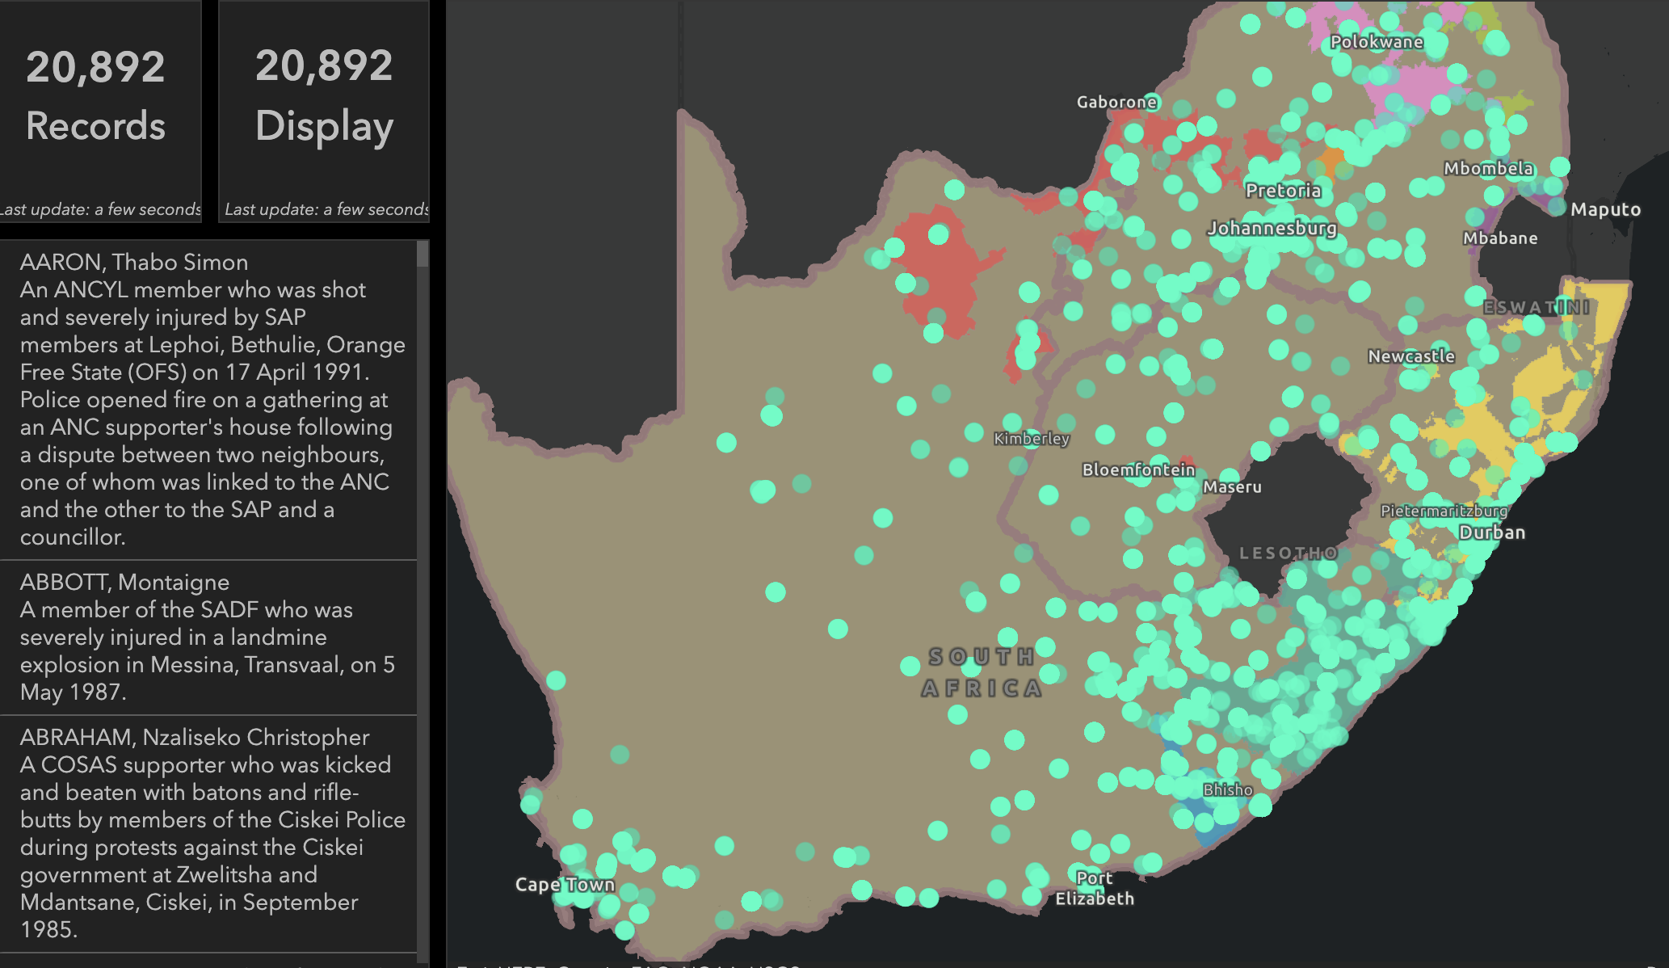
Prediction #2 – Increased Collaboration Across Disciplinary Boundaries
Bitter Aloe Project. Alpha. Do not reproduce
Notes:
And it is not just at the Roy Rosenzweig Center for History and New Media that this kind of work is happening. I sit on the board of a project at the University of Kentucky that is using natural language processing to make sense of the archives of the South African Truth and Reconciliation Commission. Let me show you two examples of their preliminary output from the alpha version of their project:

Slide 7
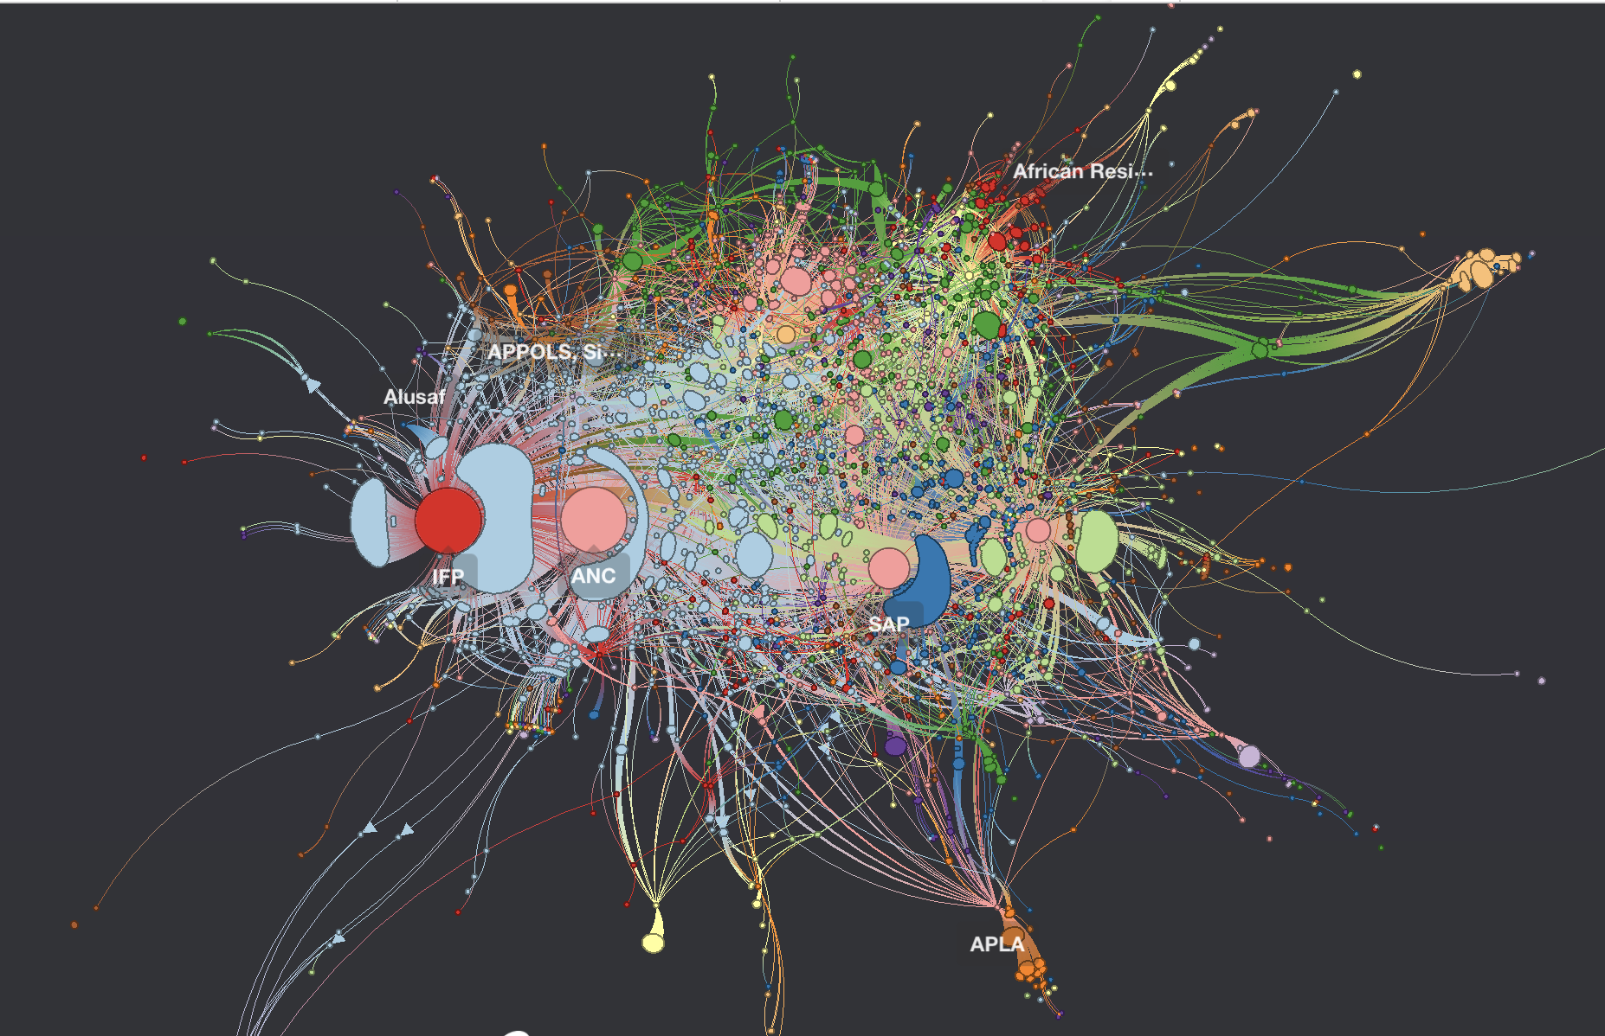
Prediction #2 – Increased Collaboration Across Disciplinary Boundaries
Bitter Aloe Project. Alpha. Do not reproduce

Slide 8
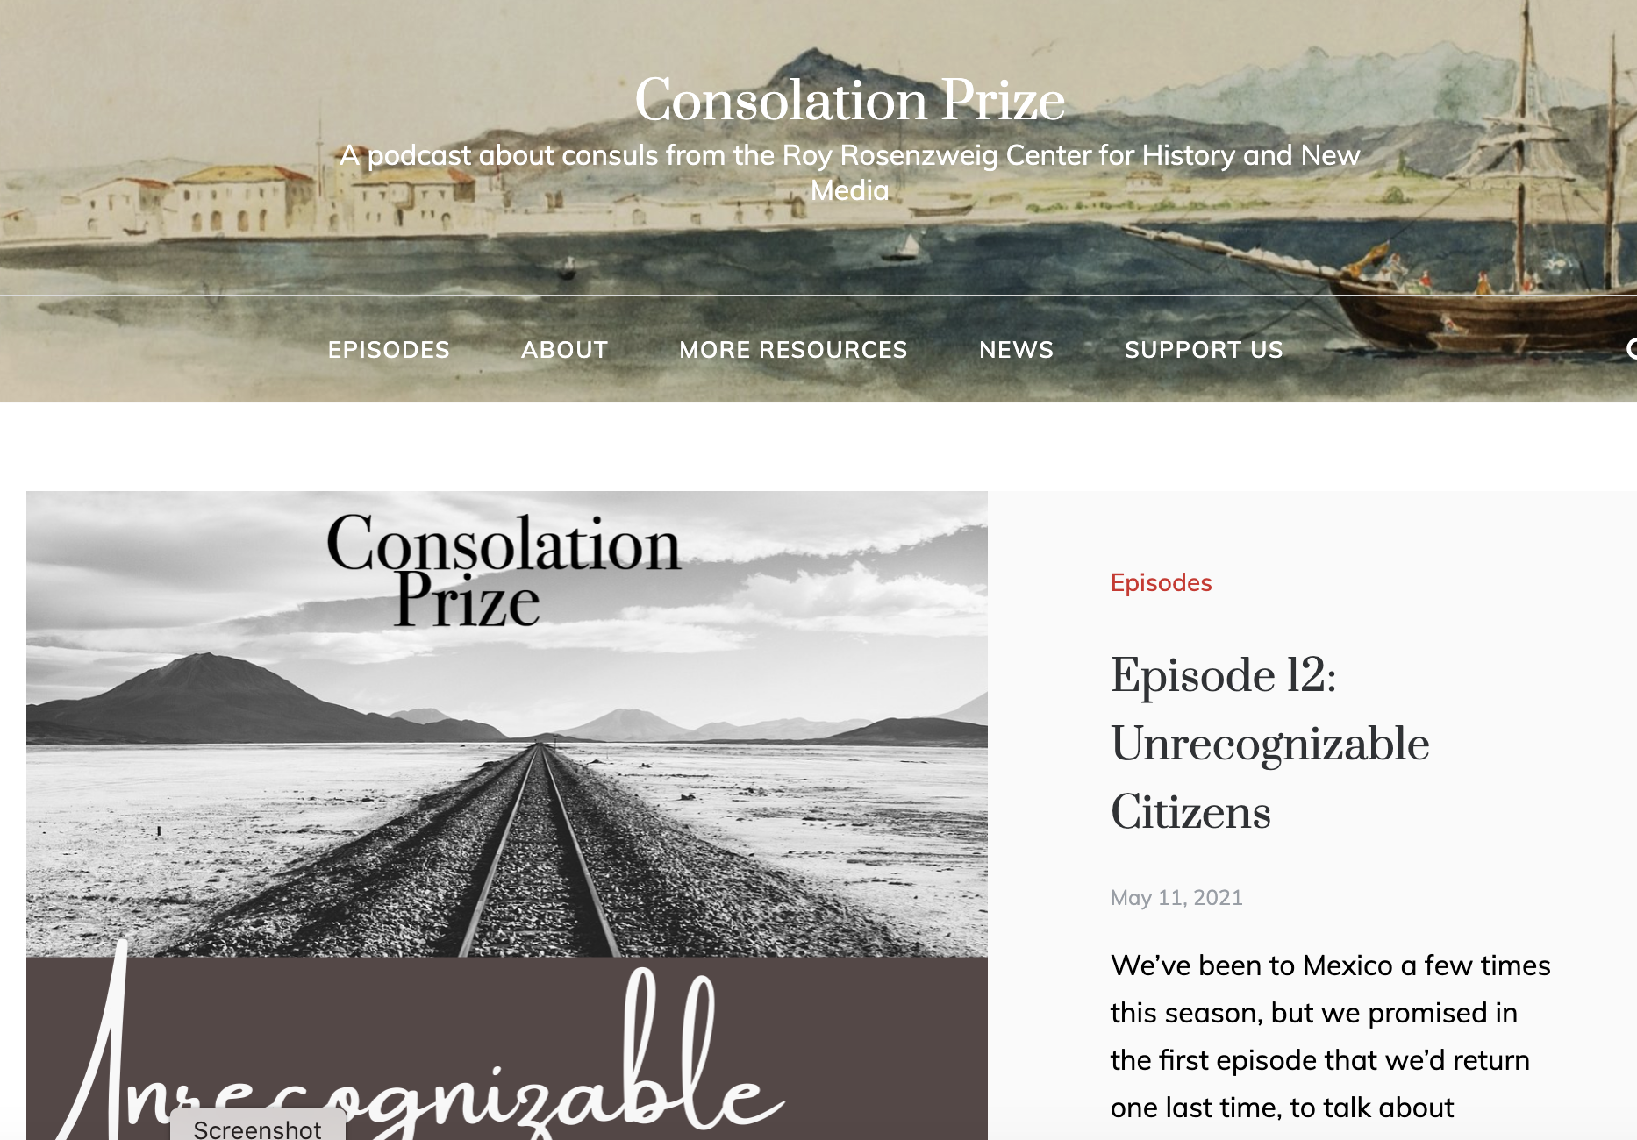
Prediction #3 – “Writing” Will Become Less Central to History Education
Notes:
Prediction #3 – Writing will become less and less important as a central aspect of history education.
This is especially true in the English-speaking world which has been heavily influenced by British traditions of essay writing, but most history curricula still require some sort of final research essay in which students are expected to demonstrate their mastery of the craft of history.
The work of historians in the Scholarship of Teaching and Learning is challenging assumptions about writing as a way of learning or demonstrating mastery of historical thinking.
Most recently, Lendol Calder and Robert Williams have published a research-based essay in the Journal of American History (March 2021) in which they argue, with evidence, that the precise connections between historical understanding and writing remain unproven.
In fact, their work suggests that less writing may be just as beneficial for cultivating historical thinking.
What if, for instance, students were asked to create podcast scripts instead of a final research paper?

Slide 9
Prediction #4 – The War on Fake History Will Consume More and More of Our Time
aljazeera.com
Notes:
Prediction #4 – Right now we are losing the war against “fake history” and so more and more of our efforts as educators will be focused on waging this war with increased energy.
This struggle is particularly acute in my own country.

Slide 10
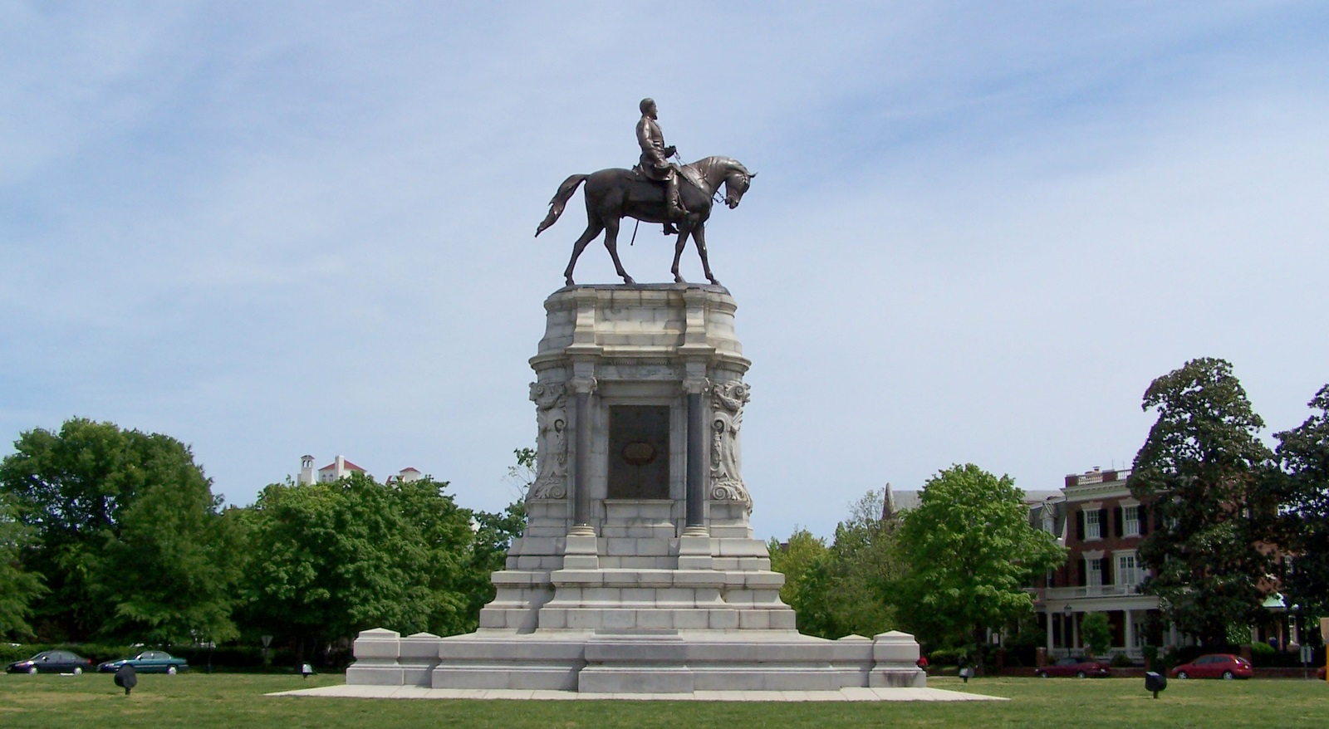
Prediction #4 – The War on Fake History Will Consume More and More of Our Time
National Archives and Records Administration
Notes:
A broad and increasingly organized coalition of politicians, activists, and average citizens is waging war against the idea that slavery has left a lasting legacy of racism in the United States.
This war originally took place in fringe publications, but has migrated to Internet communities like Facebook and Twitter and now has gone mainstream with politicians passing, or planning to pass, laws targeting the teaching of the history of structural racism.
You are all familiar, I am sure, with the images of the insurrection of January 6 like this one. But you may be less familiar with what is happening in the Virginia’s capital city – Richmond – where activists have targeted the statues on Monument Avenue which glorify the leaders of the Confederate States during the Civil War.

Slide 11
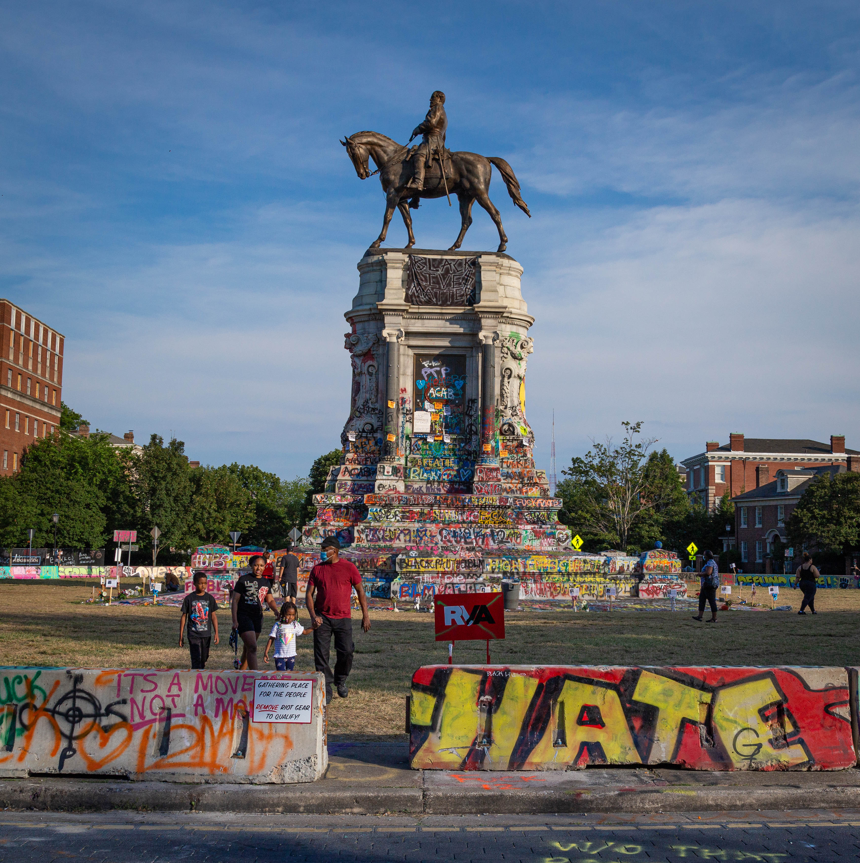
Prediction #4 – The War on Fake History Will Consume More and More of Our Time
Notes:
As educators, it will be incumbent on us to teach our students, especially those who will go on to be teachers themselves, how to weigh the credibility of online information, to sort out real history from fake history. This is a subject I will return to next week in my lecture about my course, Lying About the Past.
A few words here...
Prediction #5 – When the Covid times are just a bad memory of a lost year, some of what we learned about just-in-time online teaching will remain.

Slide 12
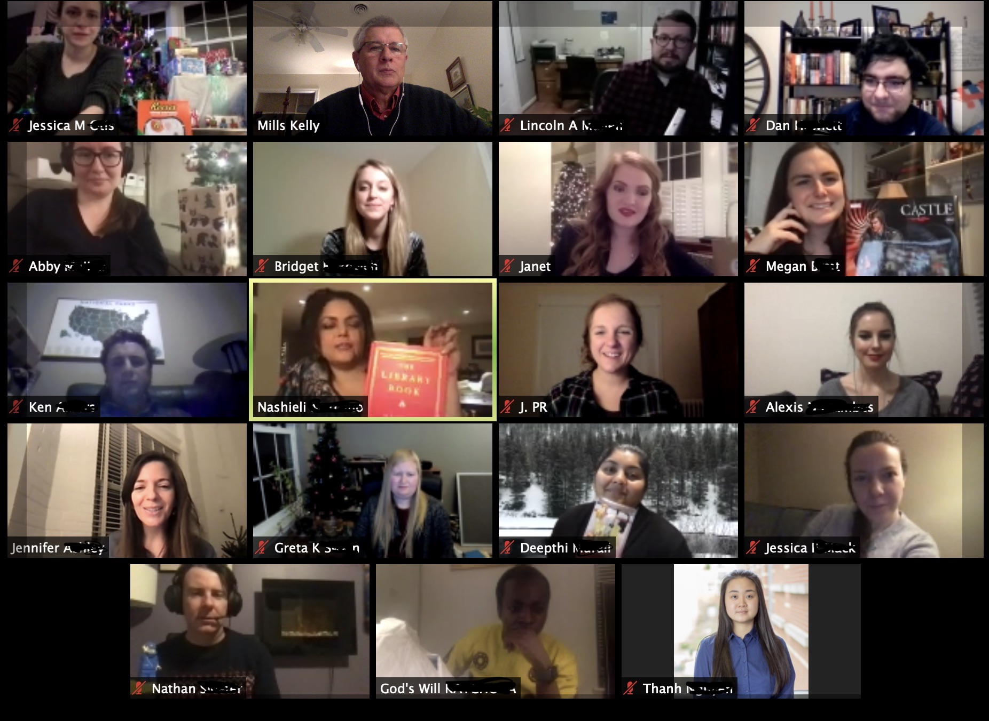
Prediction #5 – Some Online Teaching is Here to Stay
Notes:
As much as I dislike interacting with students exclusively via Zoom and Teams, I have to admit that there are advantages as well.
For example, I suspect that we will see more and more small group interactions taking place in these platforms outside the bounds of what we think of as “class time.”
Our first full-scale foray into this world was forced on us by a virus. But I suspect that five years from now we will find that at least some of what we’ve done this past year has real utility.
Conclusion
Will I be correct about everything I propose here? Probably not, but maybe. Only time will tell.
For 20 years I have been a close observer of the ways that digital technology is changing the teaching and learning of history. Those observations convince me that I’m probably right for most of these predictions.
No matter what, here’s what I know for sure:
We will teach in a world where there is simply far too much historical information available, information that can only be understood through computational methods and distant reading.
We will teach students who are increasingly familiar with the creative power of the Internet.
We will face ever greater challenges to the authority of our discipline from those who would deploy history for political means and a significant portion of the public will never believe what we say, no matter how well-researched or argued.
Finally, emerging research about teaching and learning in history will challenge our comfortable assumptions about what works and what doesn’t in our discipline. Calder and Williams’ recent essay is just one example among many.
These are real challenges, but they are also real opportunities.
Today I direct a reasonably large research center and so much of the joy I feel as a historian derives from facilitating the work of brilliant younger scholars and graduate students. I still do my own work, of course, but being in a position to help others grow and develop has been a real privilege.
That helps to explain why the examples I’ve shown today are derived from the work of other scholars and teachers rather than from my own practice as a historian and educator.
I’m happy to talk about my own work at any time, but I thought it would be more interesting to talk about the work of historians I know and respect.
I hope that at least some of these examples and predictions have sparked some new ideas for you and I look forward to responding to your questions and comments.
Thank you.

